Slide 1
TeamOrg
Presented By:
Md. Mahfujur Rahman(011161156)
Syed Adib Arman(011161251)
Nazia Parvin Urmi(011161201)
Syeda Fabliha Rahman(011161152)
Progya Paromita Urmee(011161157)

Slide 2



What is TeamOrg?
.

Slide 3
Objectives(Goals):
Team Collaboration
To make it easy to manage tasks
Projects getting done by deadlines
Create connection between manager and employee
Getting information about progress of the project automatically
Less time consuming

Slide 4
Users
Agencies
Software companies
Small businesses
IT , developers and technology companies

Slide 5
SIMILAR TOOLS:
Proofhub
Asana
Workzone
Teamwork
Usersnap
Kanbanize
Paymo
Scoro

Slide 6
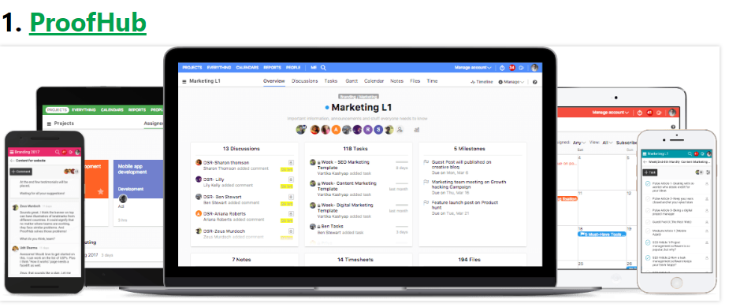
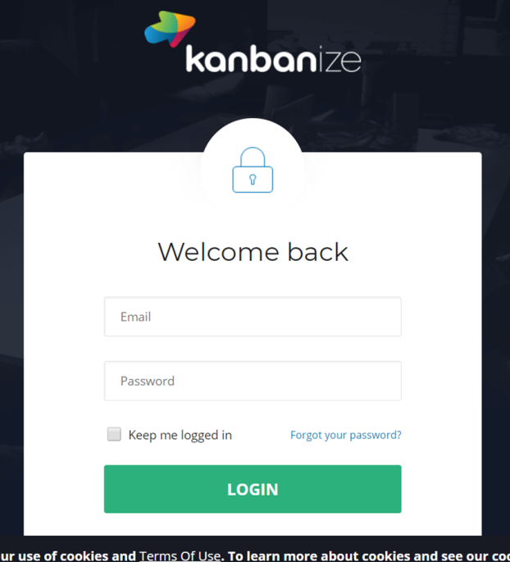
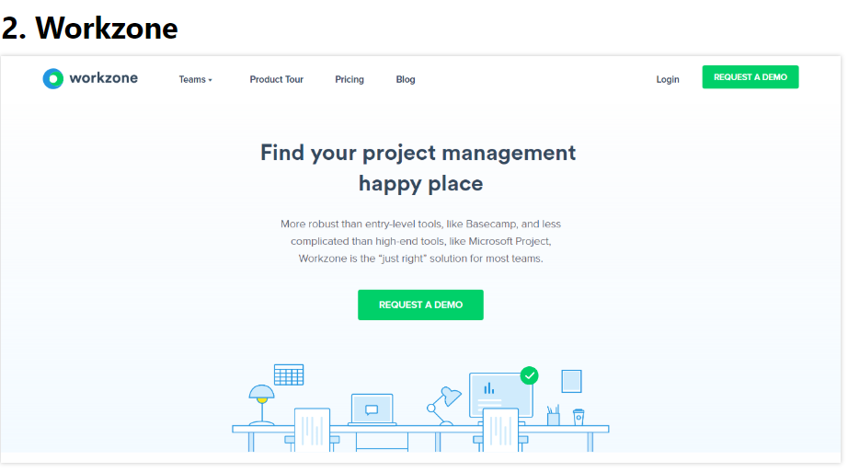
Similar Tools All-In-One Project Management Tool

Slide 7
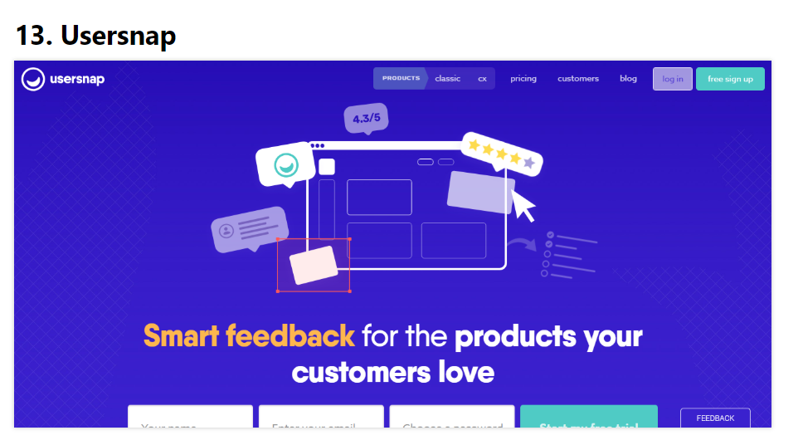
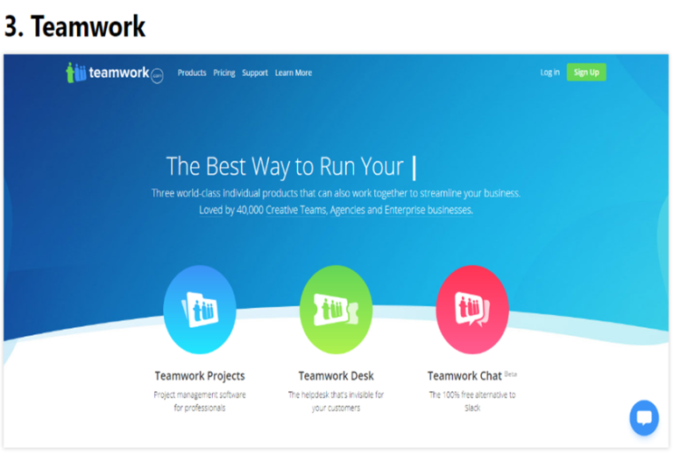
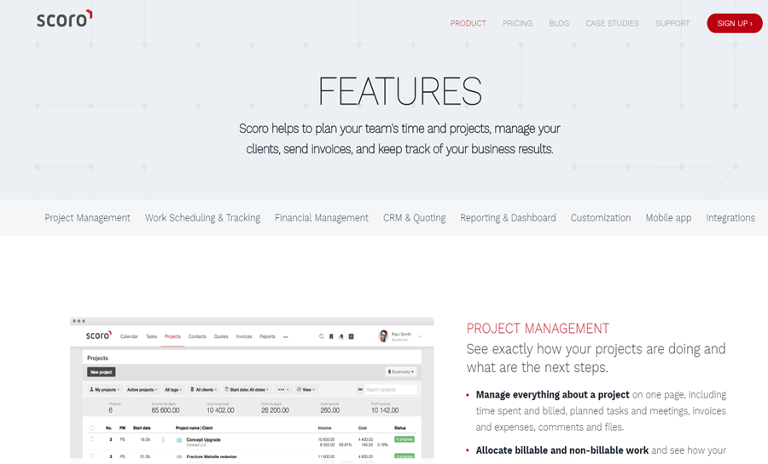
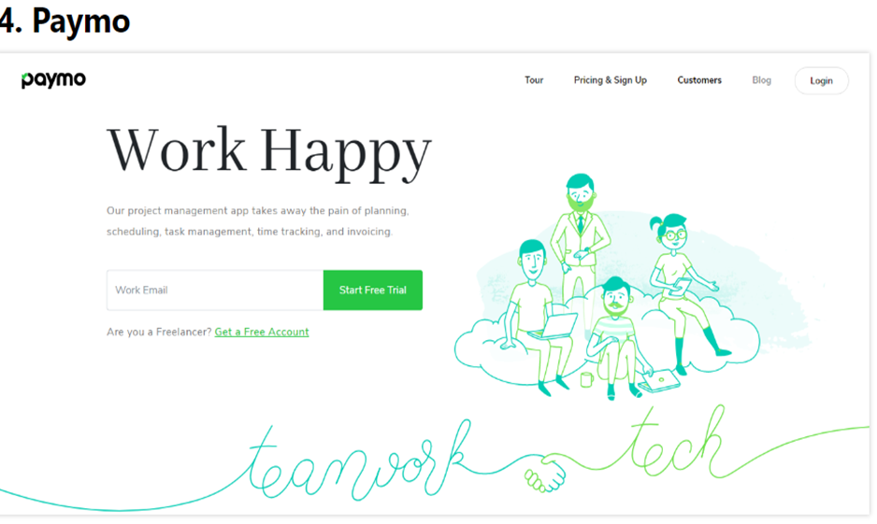

Slide 8
All-In-One (Features)
Proofhub
kanbanize
Teamwork
workzone
Teamorg
usernap
scoro
paymo

Slide 9
Benchmark Study
Add task and subtask analysis
Task list and progress list analysis
Discussion and chat analysis
Employee list analysis
Notifications analysis
Task Gantt Chart analysis

Slide 10
Comparison Table….

Slide 11
 | Paymo | Scoro | Teamwork | Usersnap | Asana | Trello | Kanbanize | Proofhub | Team Org
Add task | Yes | Yes | Yes | No | Yes | Yes | Yes | Yes | Yes
Subtask | Yes | No | No | No | No | No | No | No | Yes
Task & progress list | Yes | Yes | No | No | Yes | No | No | No | Yes
Discussion & chat | No | Yes | No | No | Yes | No | No | yes | Yes
Employee table | No | No | Yes | No | No | No | No | No | Yes
Task Dependency | No | No | No | No | No | No | Yes | No | Yes
Notification | No | No | Yes | No | Yes | Yes | No | No | Yes
Gantt chart | Yes | No | Yes | No | Yes | Yes | No | Yes | Yes

Slide 12
Proposed project features:
Create tasks and subtasks assign them to team members
Send messages to team members directly through chat
Individual To-do lists focus each person on what needs to get done
Create task dependencies
Ability to check anyone’s progress
Employee informations

Slide 13
Features that won’t be implemented:
Notifications
Gantt chart
*These features can’t be implemented because of the time limitation.

Slide 14
Completed Features:
Create tasks and subtasks assign them to team members
Individual To-do lists focus each person on what needs to get done
Ability to check anyone’s progress
Employee informations

Slide 15
Technologies Used:
PHP
HTML
CSS
JAVASCRIPT
Bootstrap

Slide 16
Site map:
TeamOrg
Manager
Employee
LOG IN
LOG IN
task
Add Task
Add SubTask
Work to do
Task list
Task doing
message
message
Sub task
Employee list
Employee info
logout
Progress
Task progress
Gantt chart
Notification
Log out

Slide 17
USER INTERFACE (UI)
TeamOrg

Slide 18


Our project homepage:

Slide 19
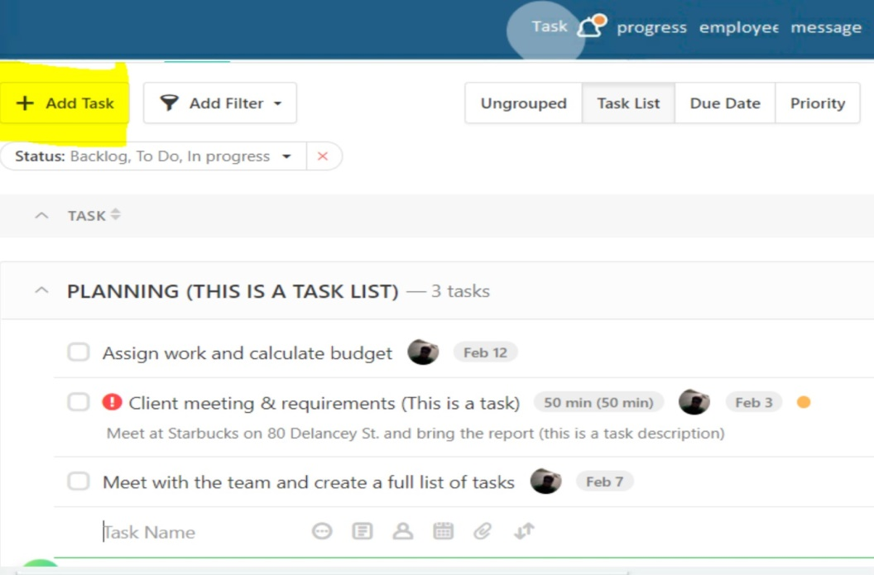
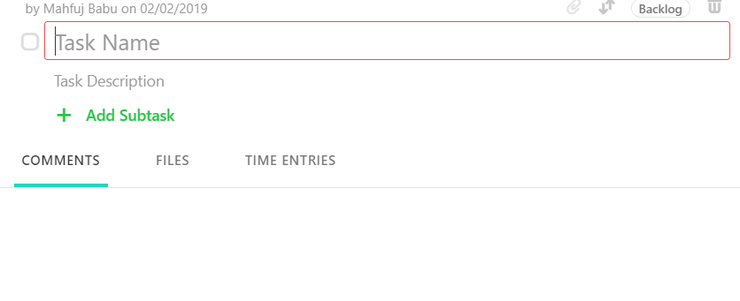
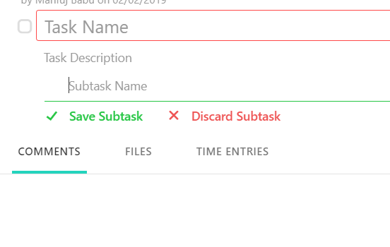
TeamOrg Features:
Add Task and Subtask
Similar to paymo

Slide 20
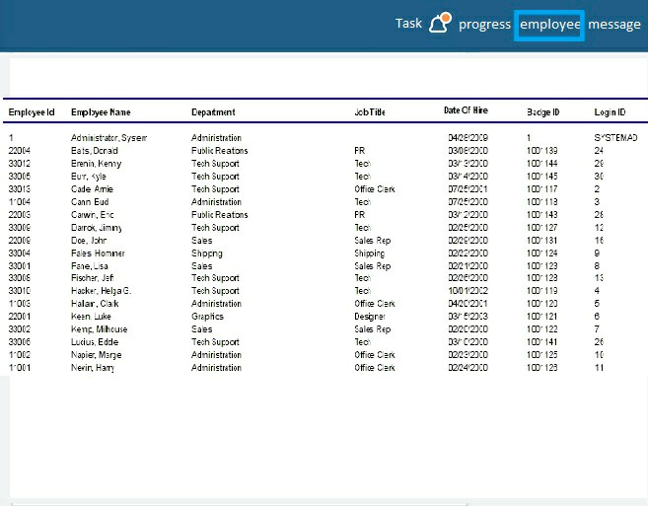
TeamOrg Features:
Employee List

Slide 21

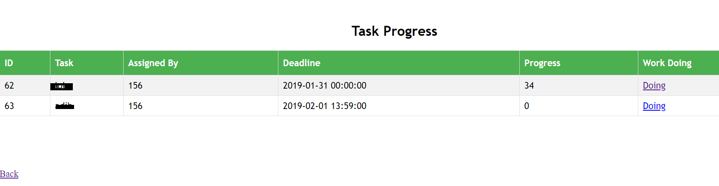
TeamOrg Features:
Task List
Adib
Urmee

Slide 22

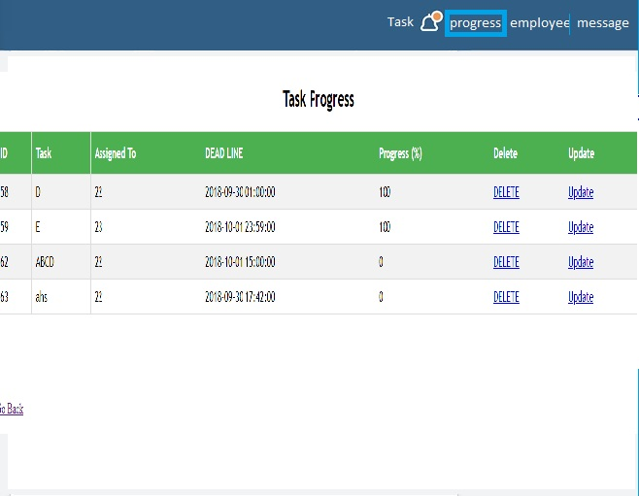
TeamOrg Features:
Progress List
Nazia
Fabliha
Mahfuj
Alien

Slide 23
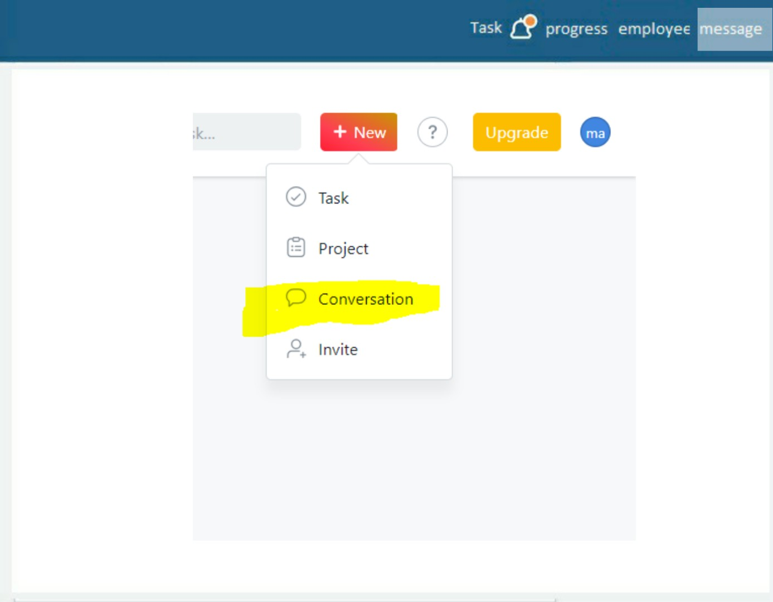
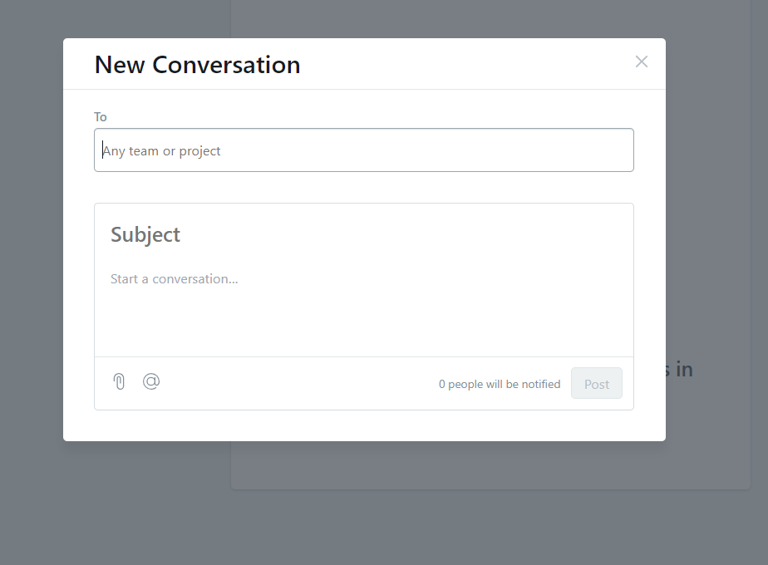
TeamOrg Feature:
Discussion
Similar to Asana

Slide 24
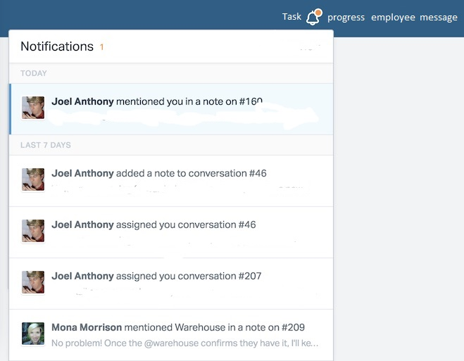
TeamOrg Features:
Notification:

Slide 25
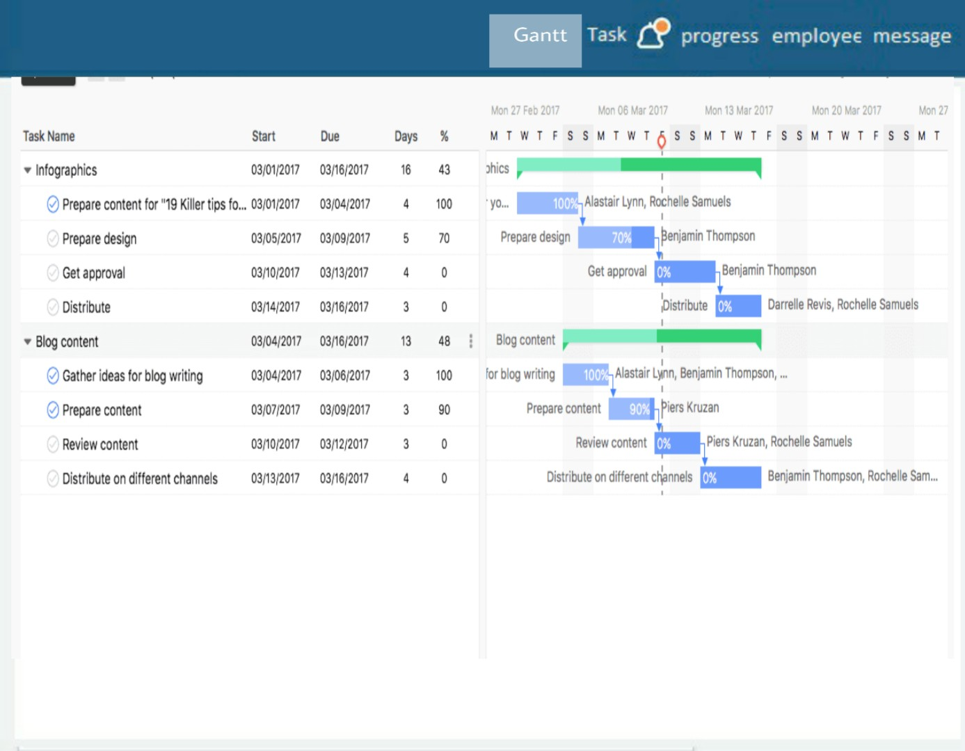
TeamOrg Features
Gantt Chart
Similar to ProofHub

Slide 26
Diagram…..

Slide 27
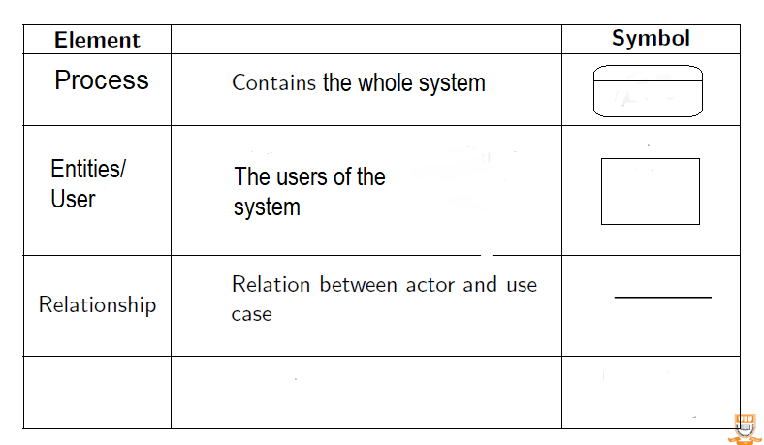
Context Diagram : SYMBOLS:

Slide 28
RULES:
There must be a single process node which is define as 0.
External Entities should be in Capital Letters.

Slide 29
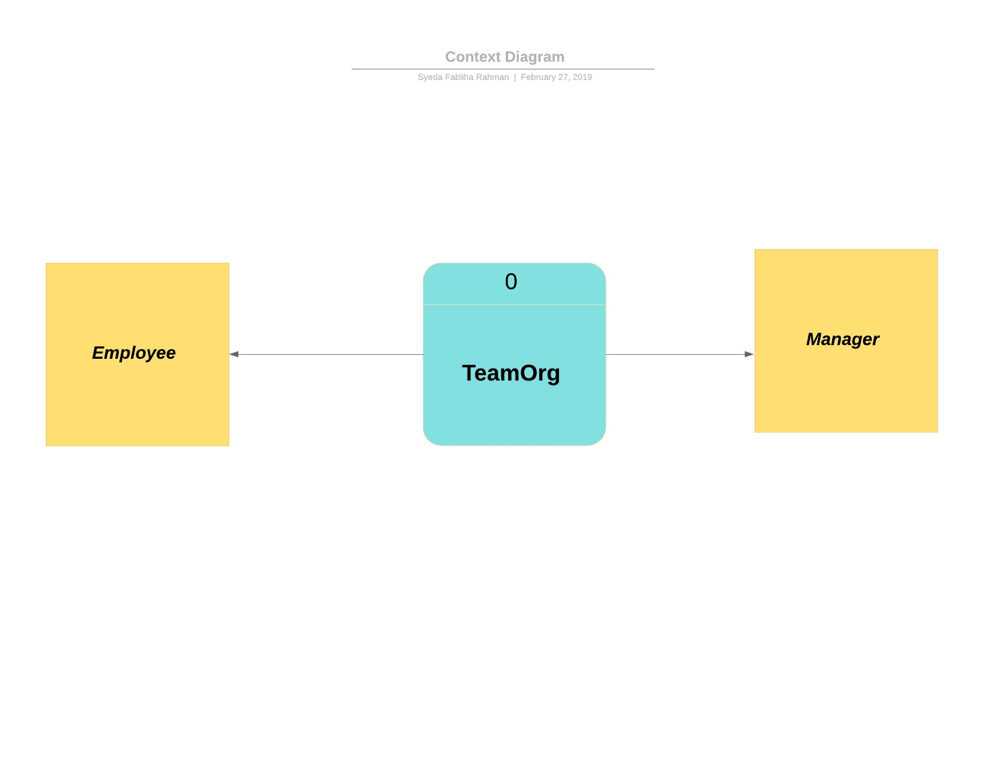
MANAGER
EMPLOYEE

Slide 30
Data Flow Diagram

Slide 31
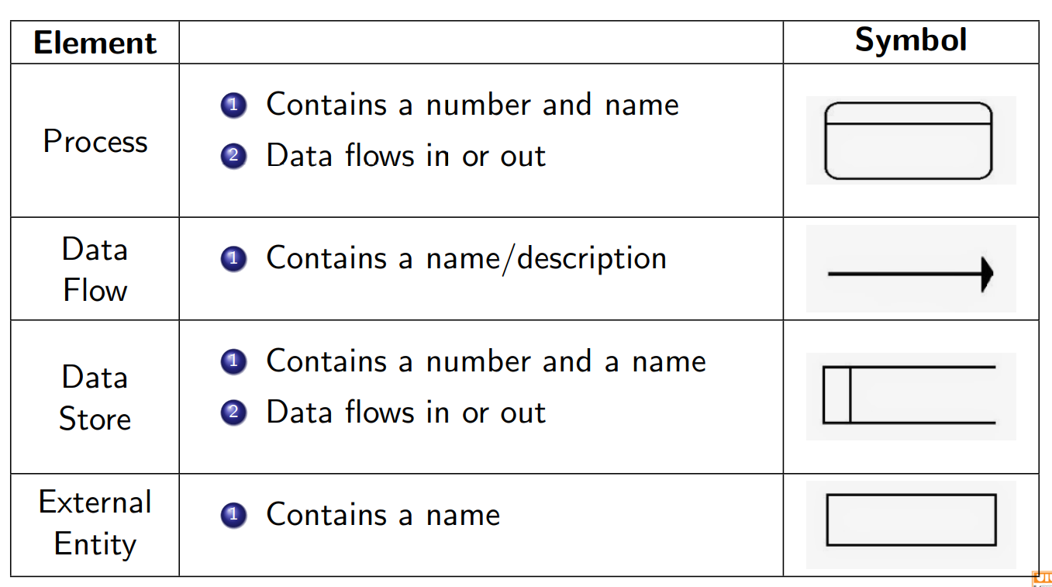
Symbols:

Slide 32
Rules:
Database name should be in Capital letters
External Entities should start with Capital letters
There should not be any connection between DB to DB, DB to external entities
Process should have name and number

Slide 33
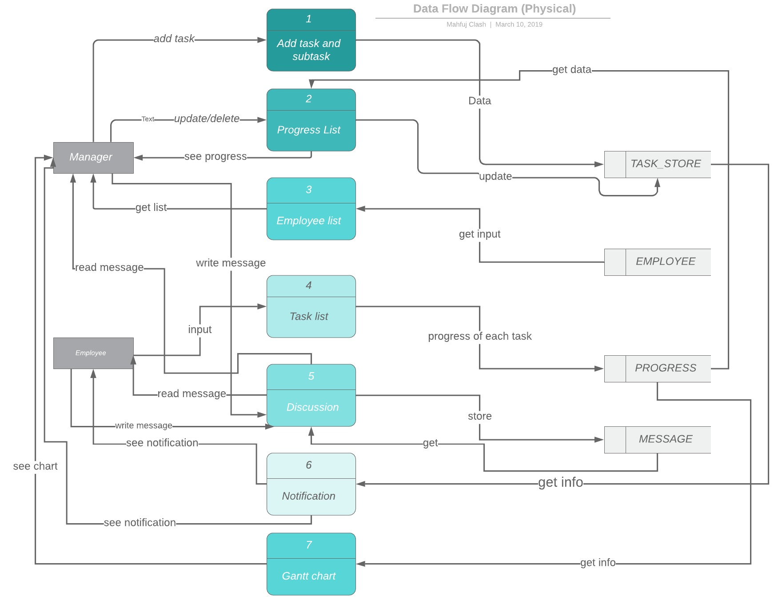

Slide 34
Activity Diagram

Slide 35
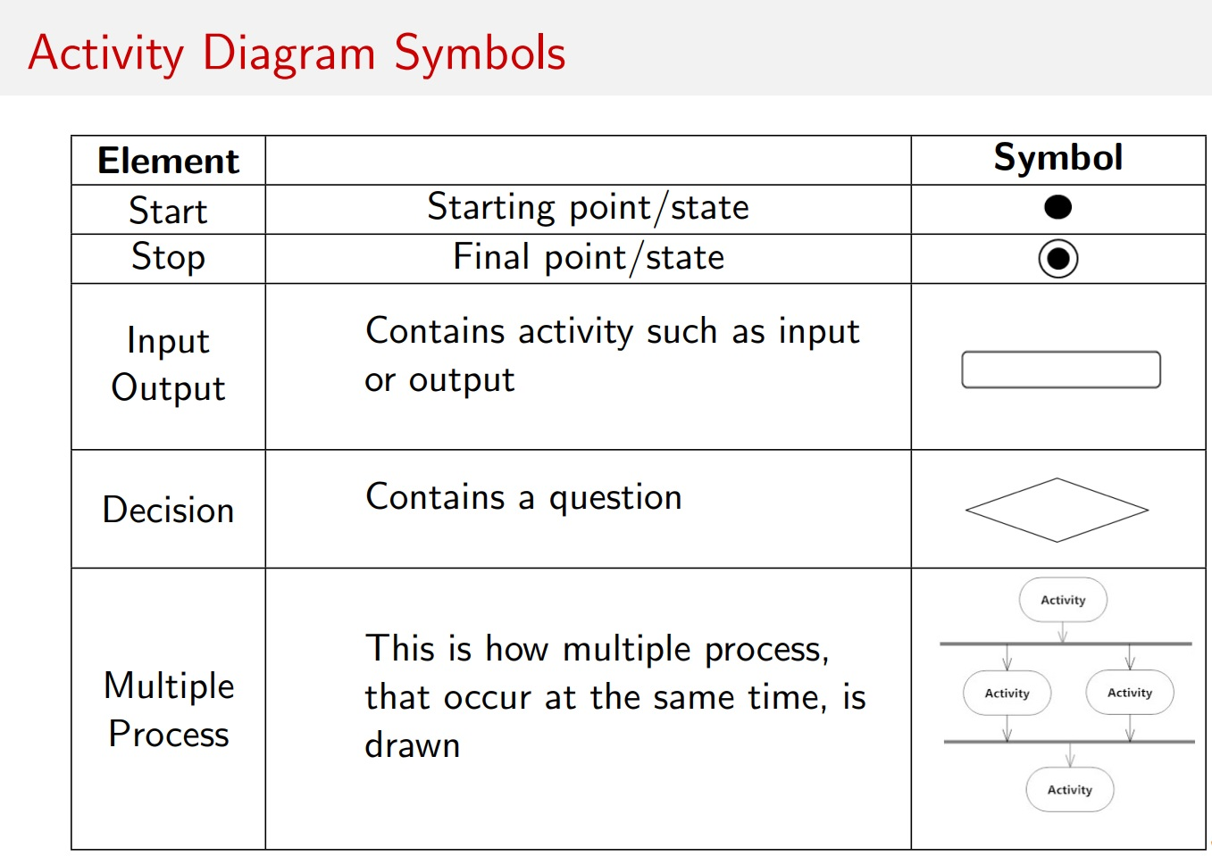
Symbols:

Slide 36

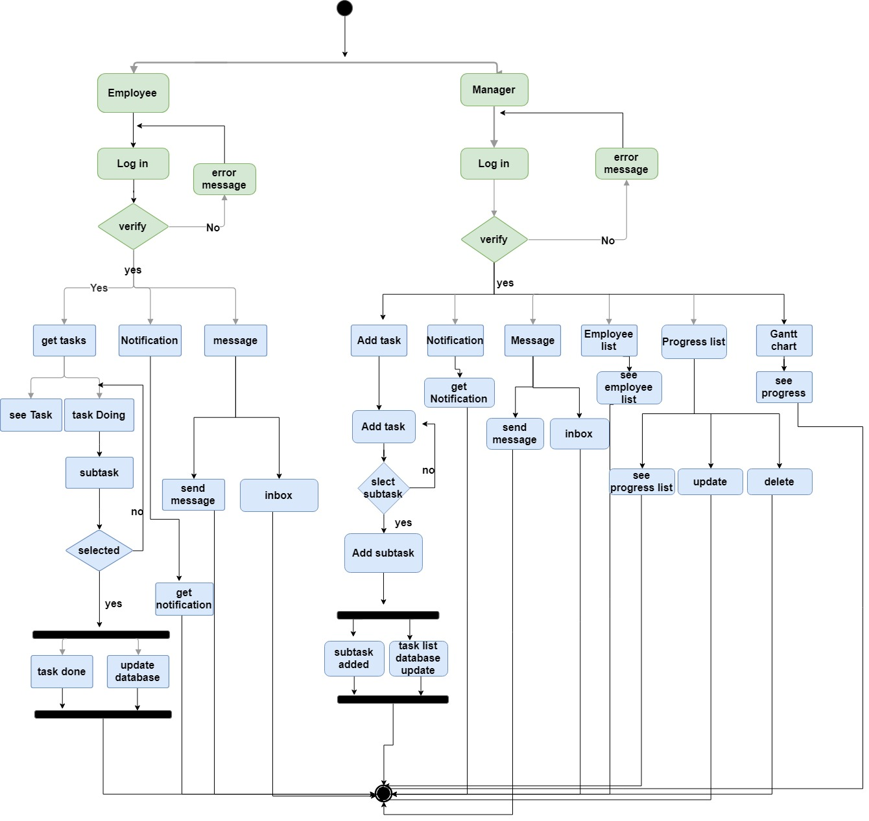

Slide 37
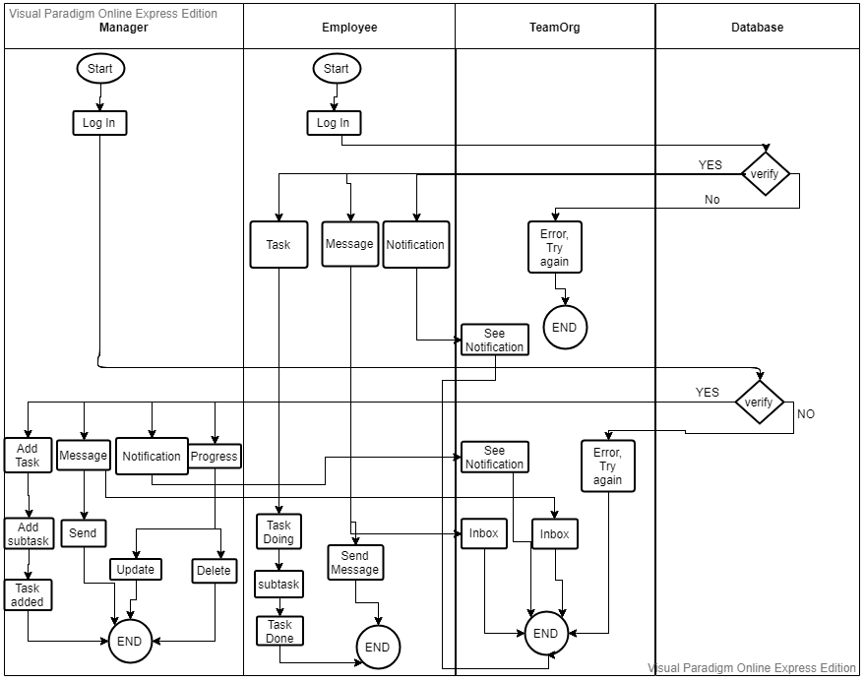
Swimlane diagram:

Slide 38
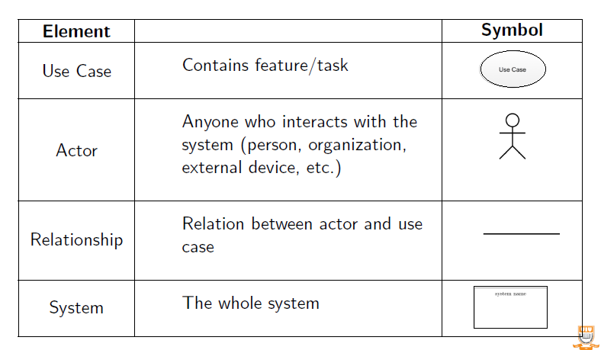
Use case SymbolS:

Slide 39
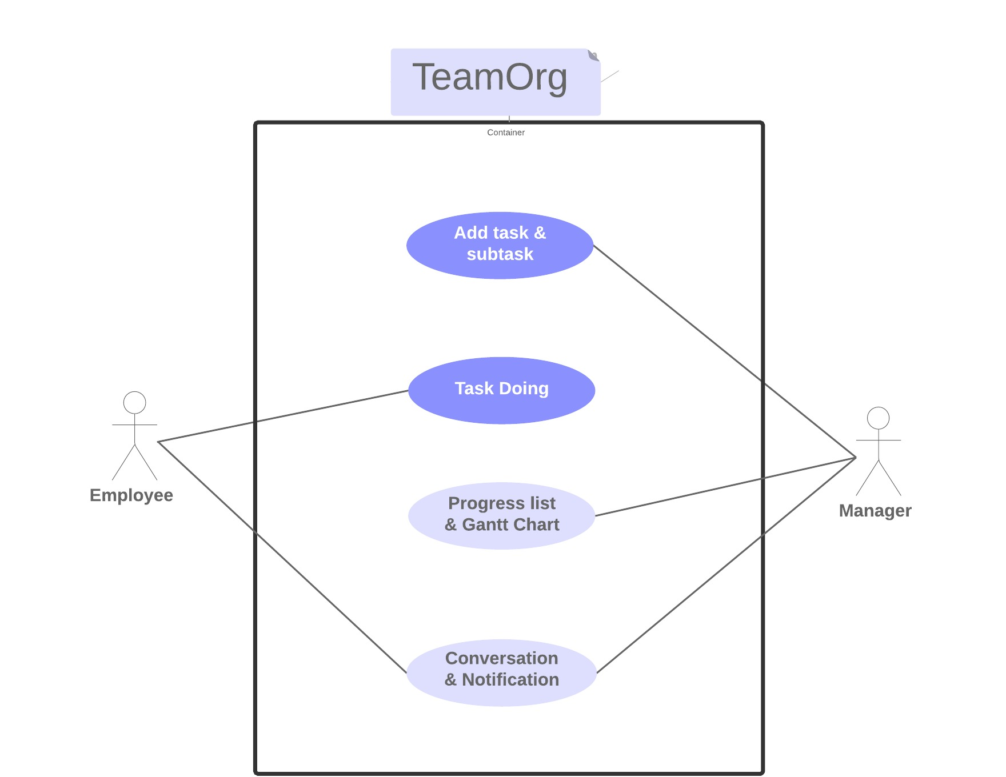
Use case Diagram:

Slide 40
Use Case Description

Slide 41
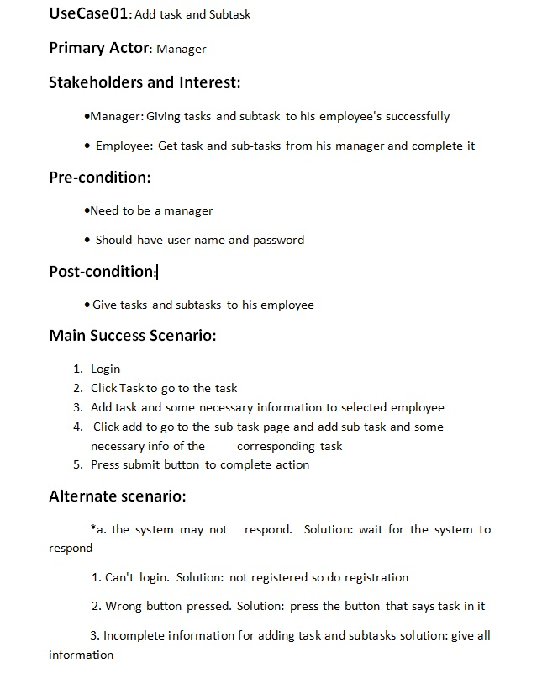
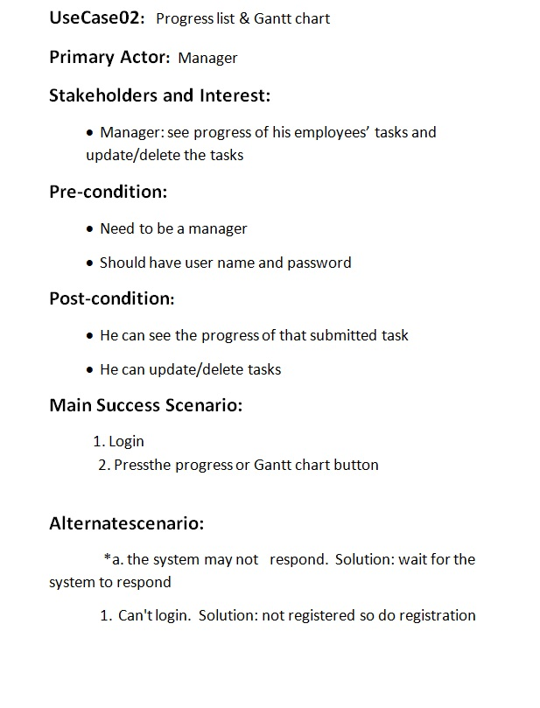

Slide 42
Use case Descriptive Form:
UC number and name
Primary Actor
Stakeholders and Interests
Pre-conditions
Success Scenario
Alternate Scenario
Post-conditions

Slide 43
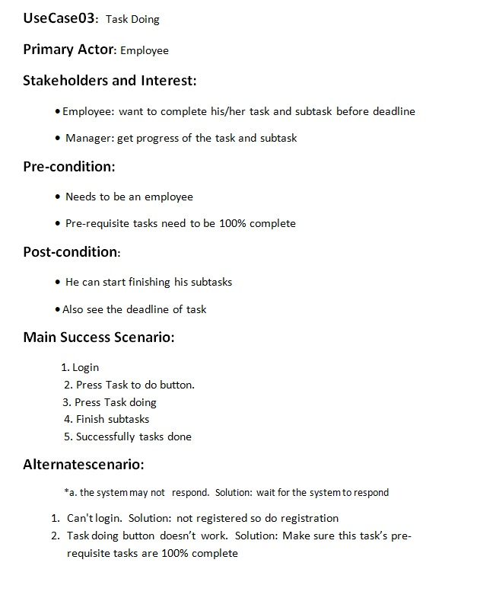
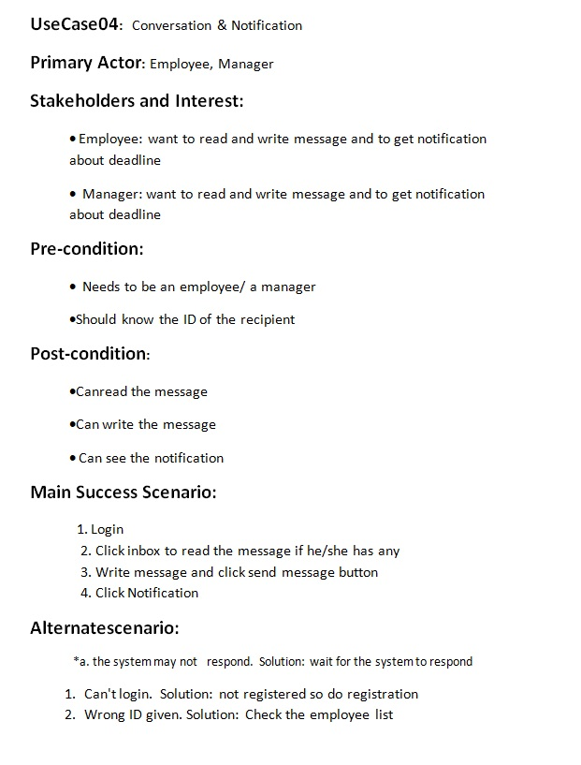

Slide 44
Symbols State Diagram:

Slide 45
Rules of State diagram:
There have to be a initial state and final state.
Every state have to be shown in rounded rectangle and have to be represented with a name.
Transition have to be made within all the states.
All the transitions have to be labeled with an event name.

Slide 46
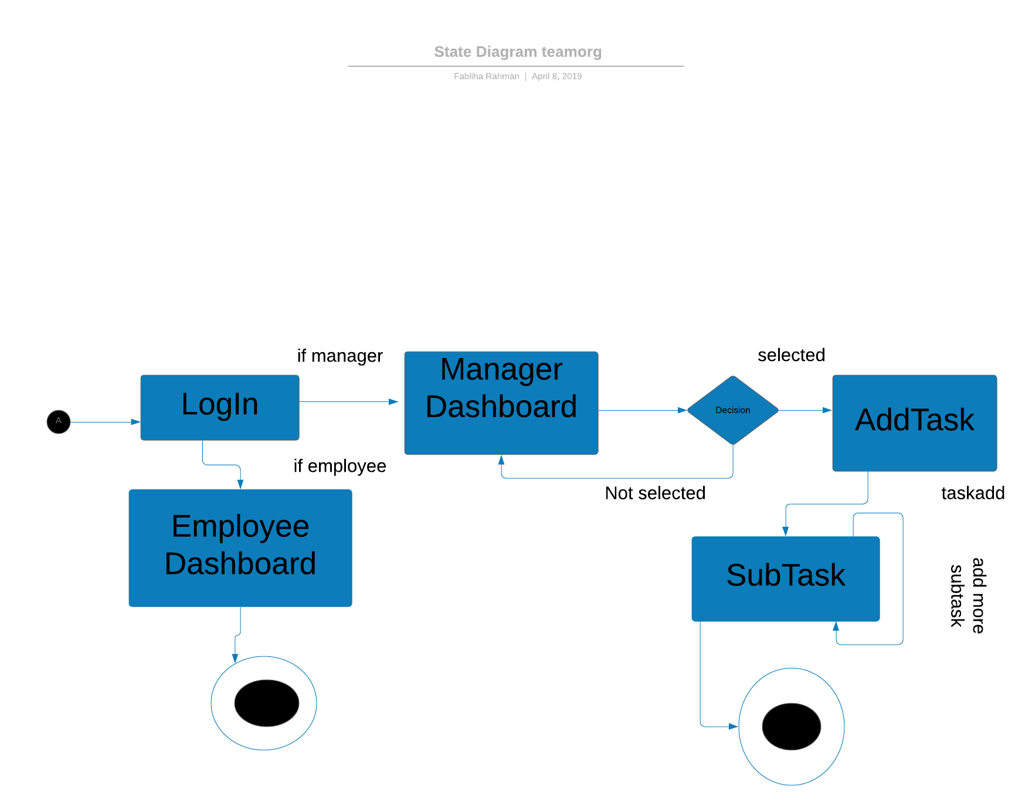
State Diagram: (Add task)

Slide 47
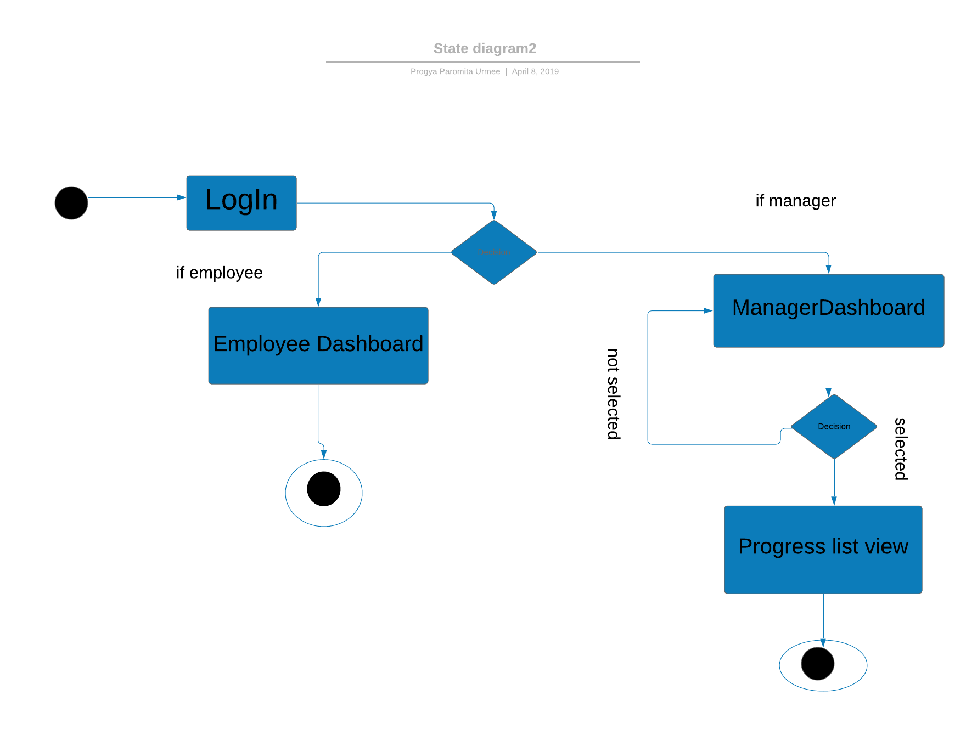
State diagram:(Progress list)

Slide 48
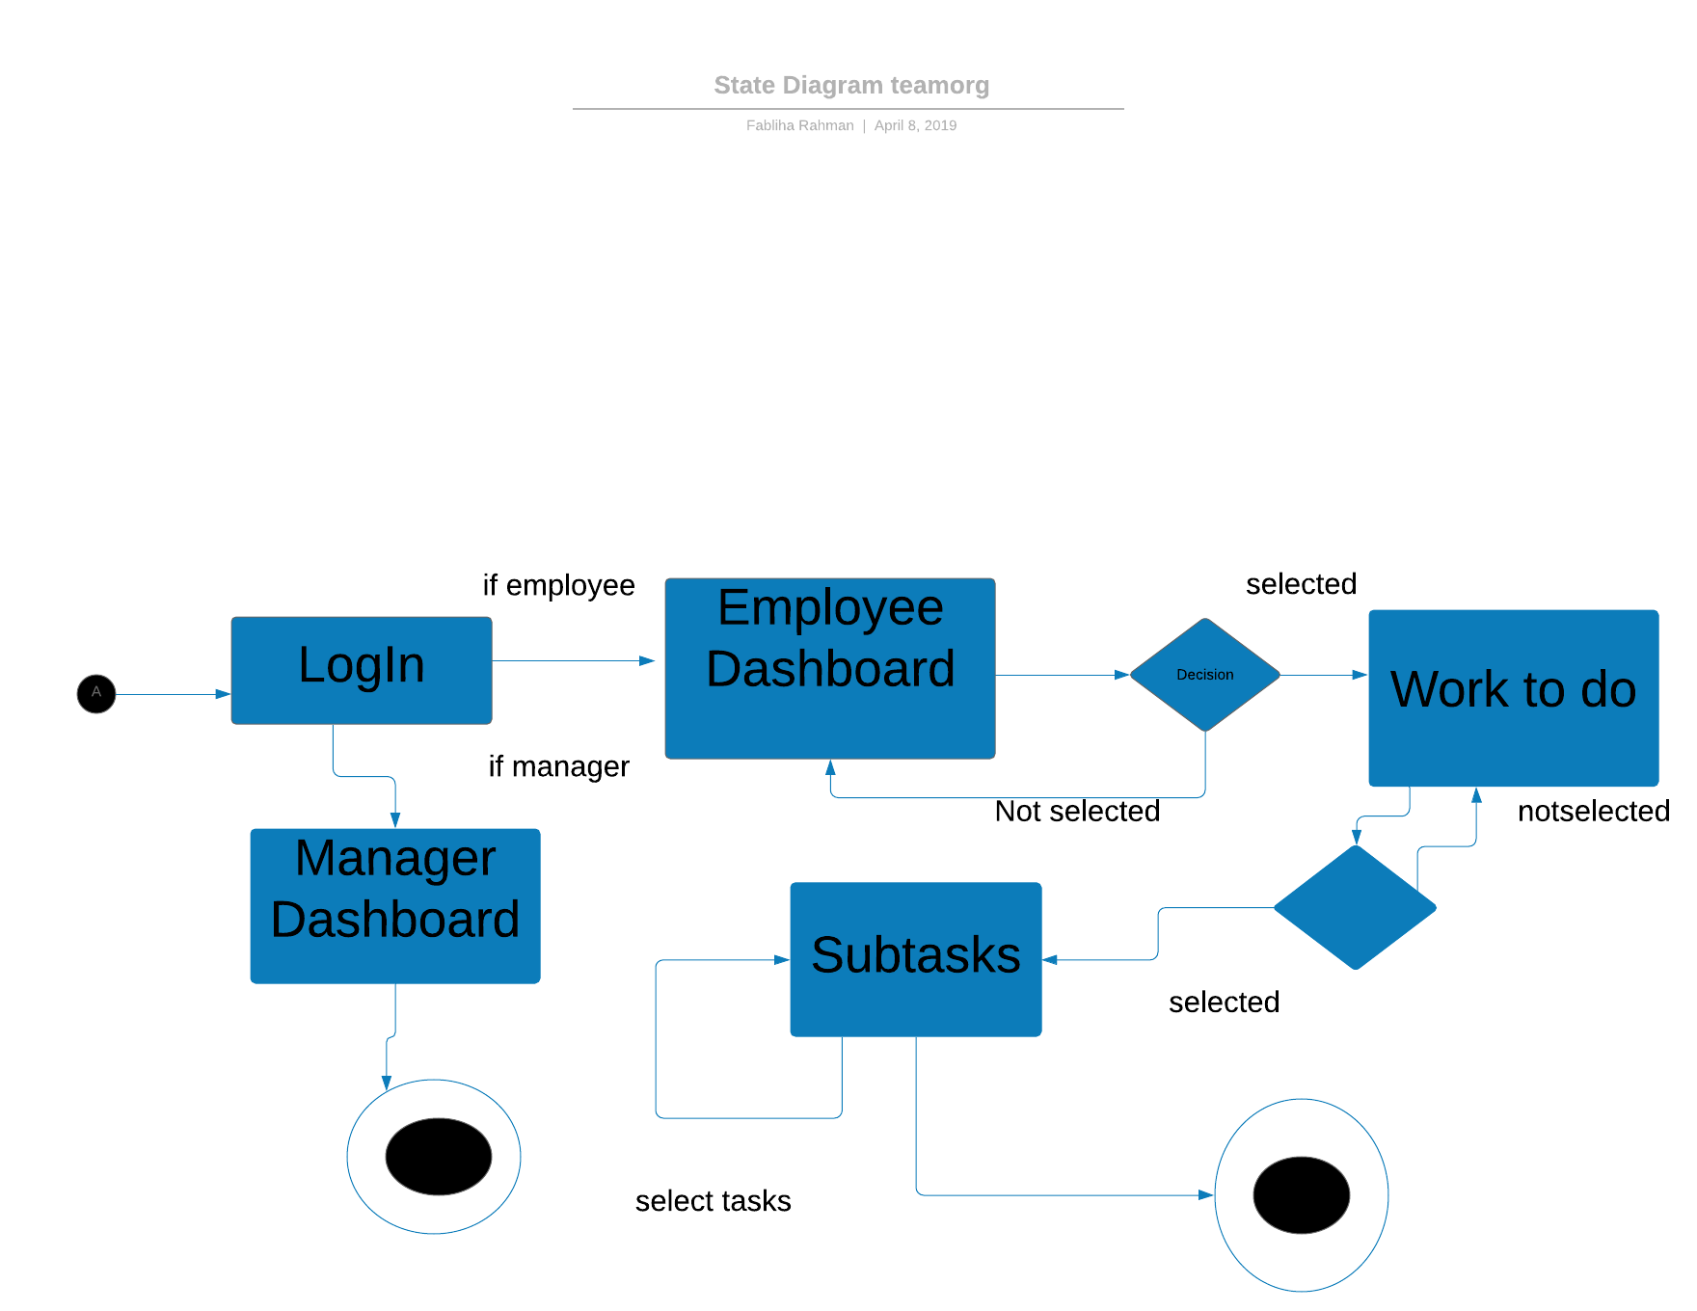
State Diagram:(Work to do)

Slide 49
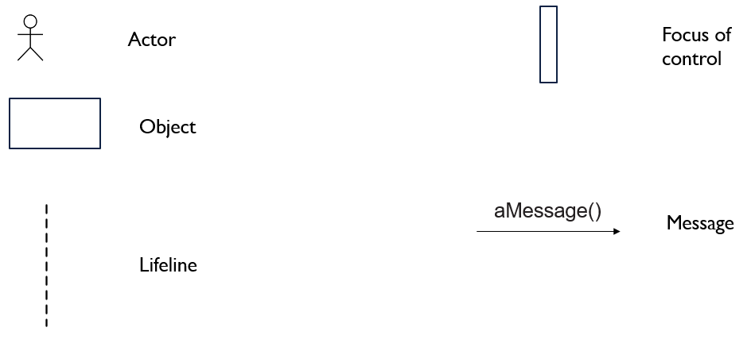
Symbols of Sequence diagram:

Slide 50
Rules of Sequence Diagram:
Start from left
Place actor on the left most side of the diagram
Name actor consistently with use case diagram
Name classes consistently with class diagram

Slide 51
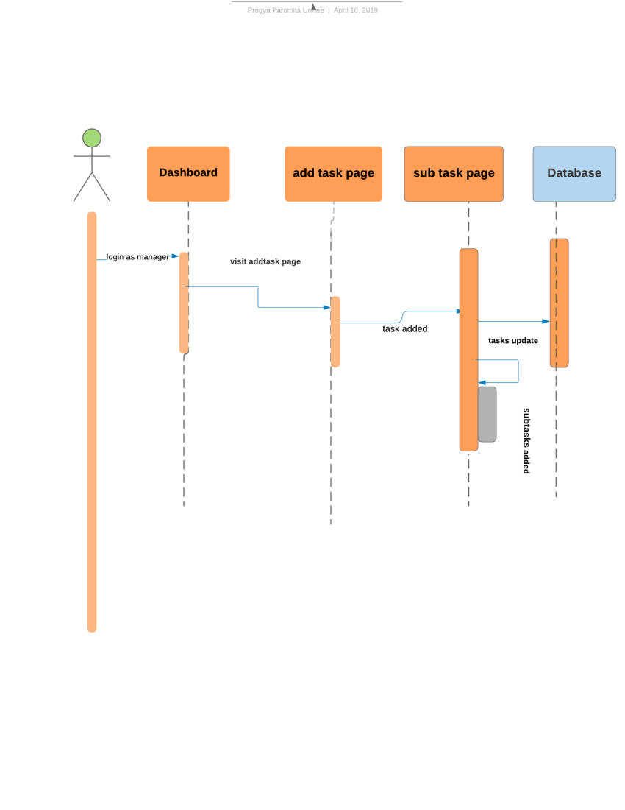
Sequence Diagram:(Add task)

Slide 52
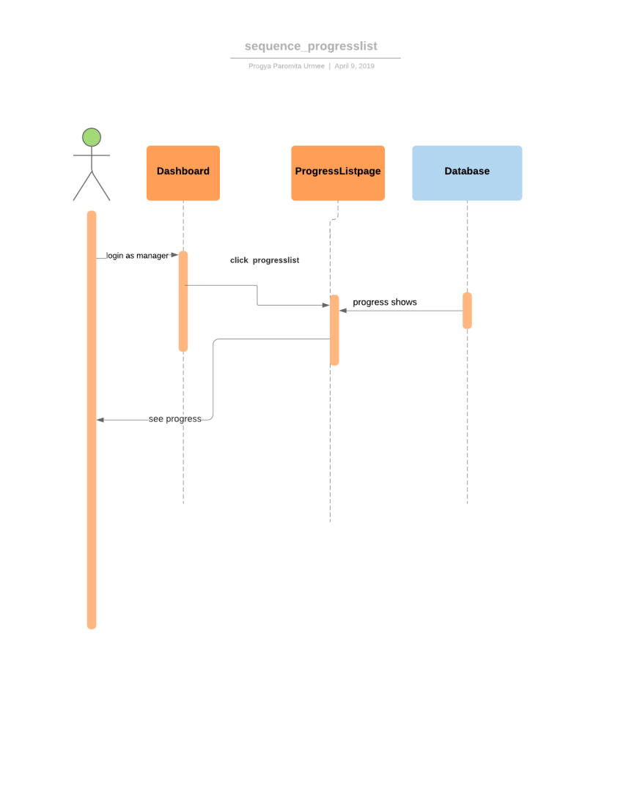
Sequence Diagram:(Progress list)

Slide 53
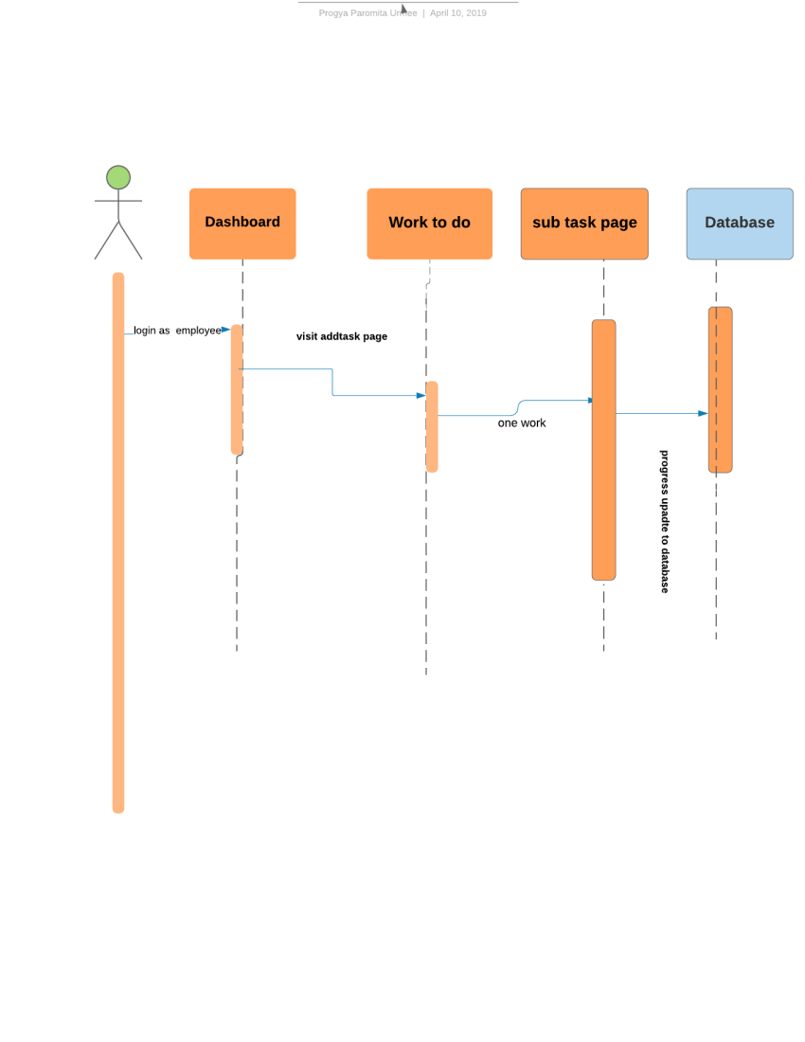
Sequence Diagram:(Work to do)

Slide 54
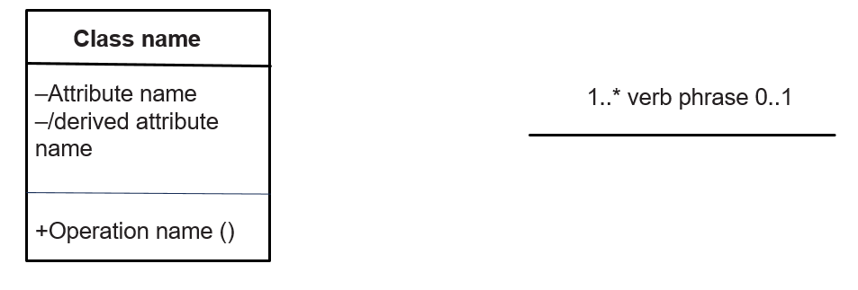
Symbols of Class diagram:

Slide 55
Rules of Class Diagram:
Show visibility only on design models
Assess responsibilities on domain class diagrams
Highlight language-dependent visibility with property strings
Highlight types only on design models
Highlight types on analysis models only when the type is an actual requirement

Slide 56
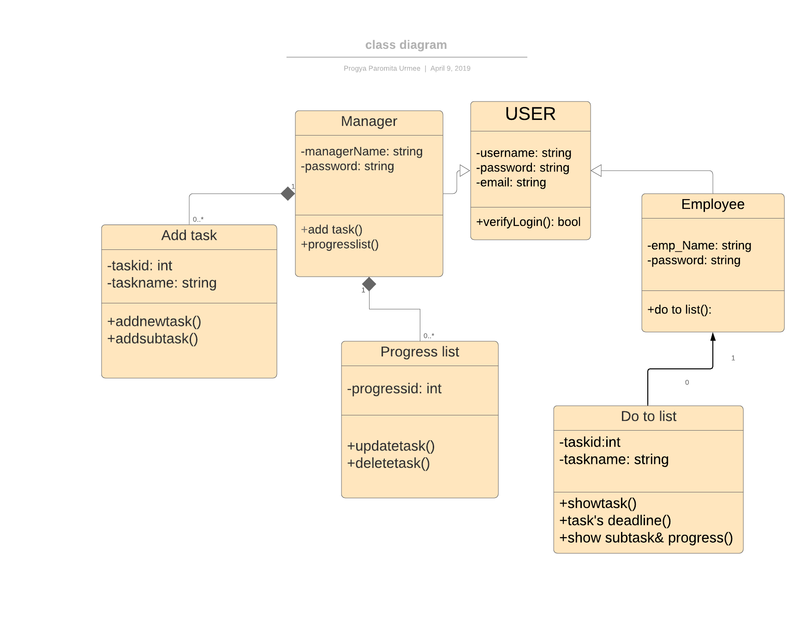
Class Diagram:

Slide 57
Class Responsibilities Collaboration Diagram (CRC)

Slide 58
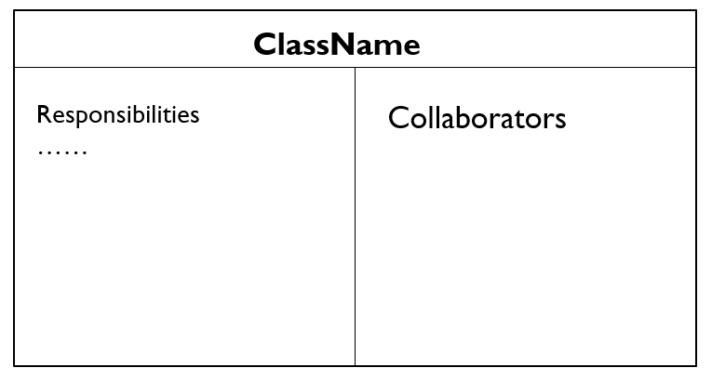
Symbols:

Slide 59
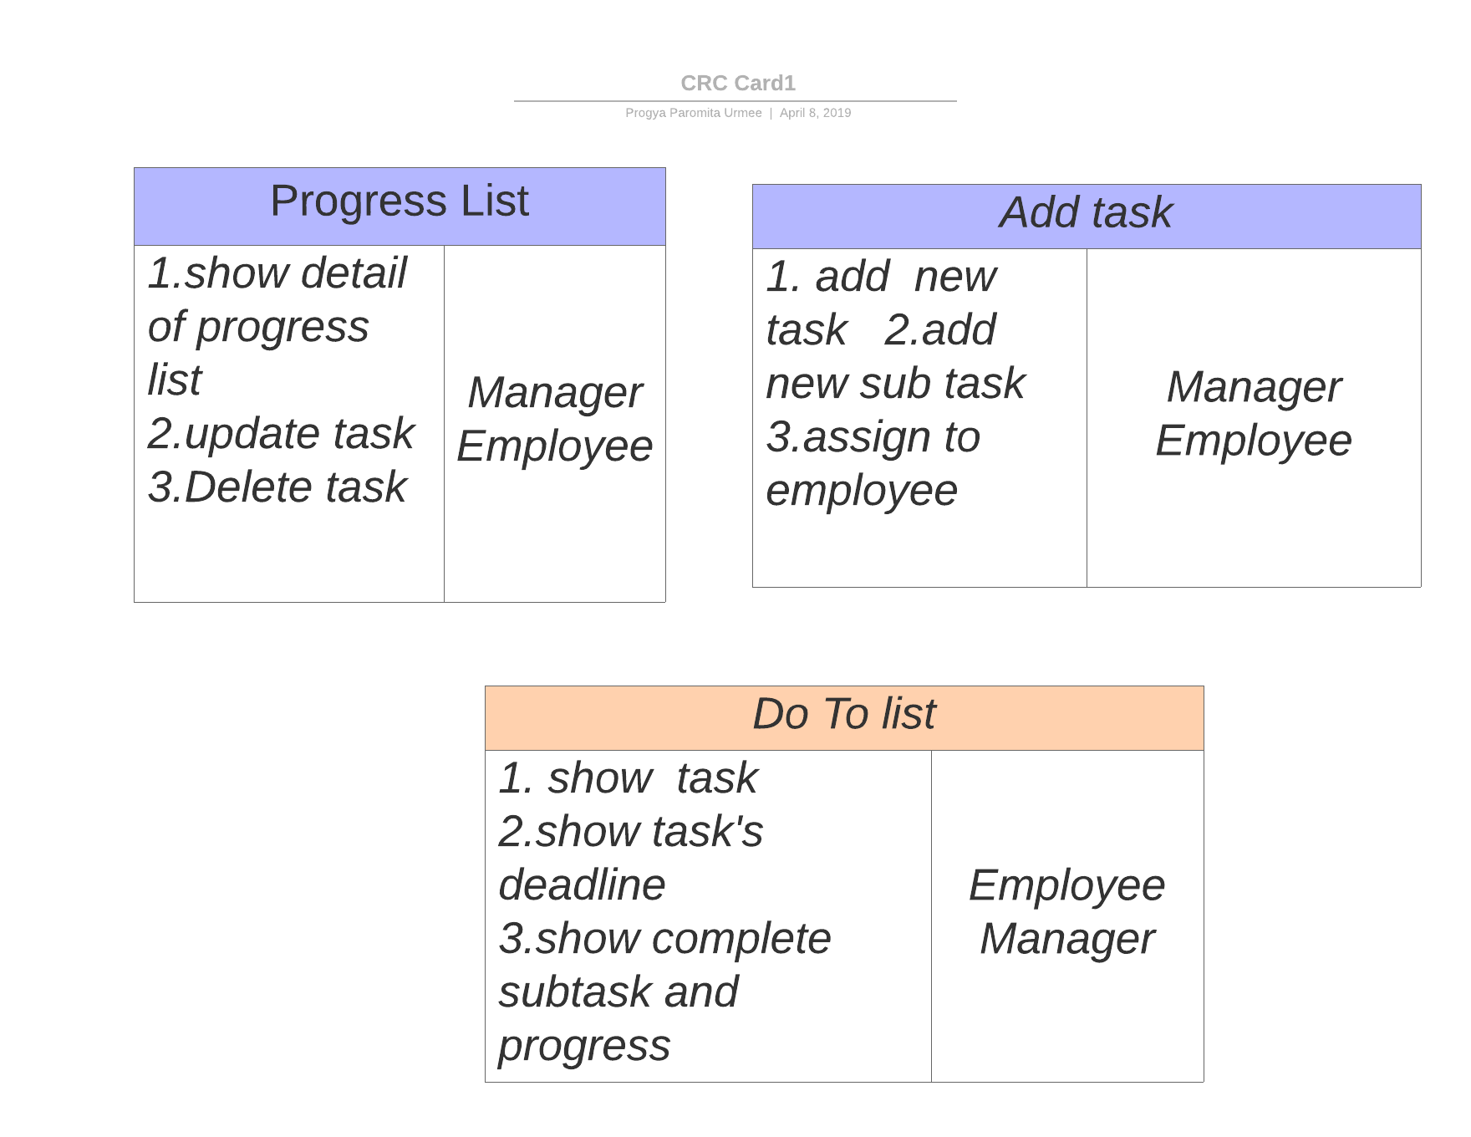
CRC card:

Slide 60
Project Management Tool: Trello

Slide 61
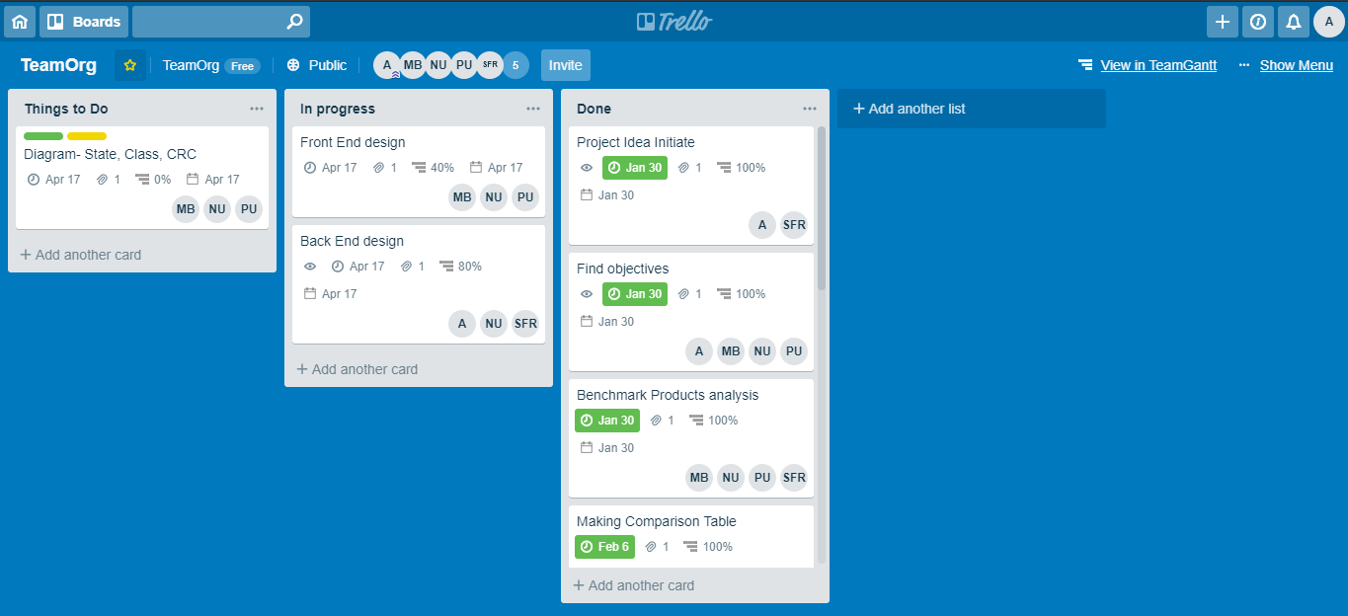

Slide 62
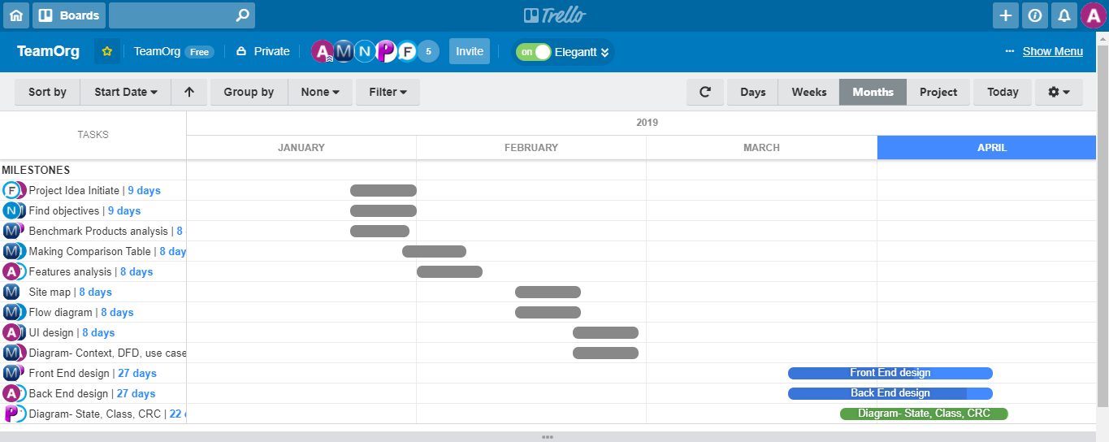

Slide 63
Contribution:
Syeda Fabliha Rahman: Benchmark analysis, UI, Backend, diagram,Report.
Md. Mahfujur Rahman: Benchmark analysis, Diagram, Frontend
Progya paromita Urmee: Benchmark analysis, UI, frontend, diagram , Report.
Nazia parvin Urmi: Benchmark analysis, UI, backend, frontend
Syed Adib Arman : Benchmark analysis, Backend, Diagram, UI

Slide 64
Thank You All…..

